Slide 1
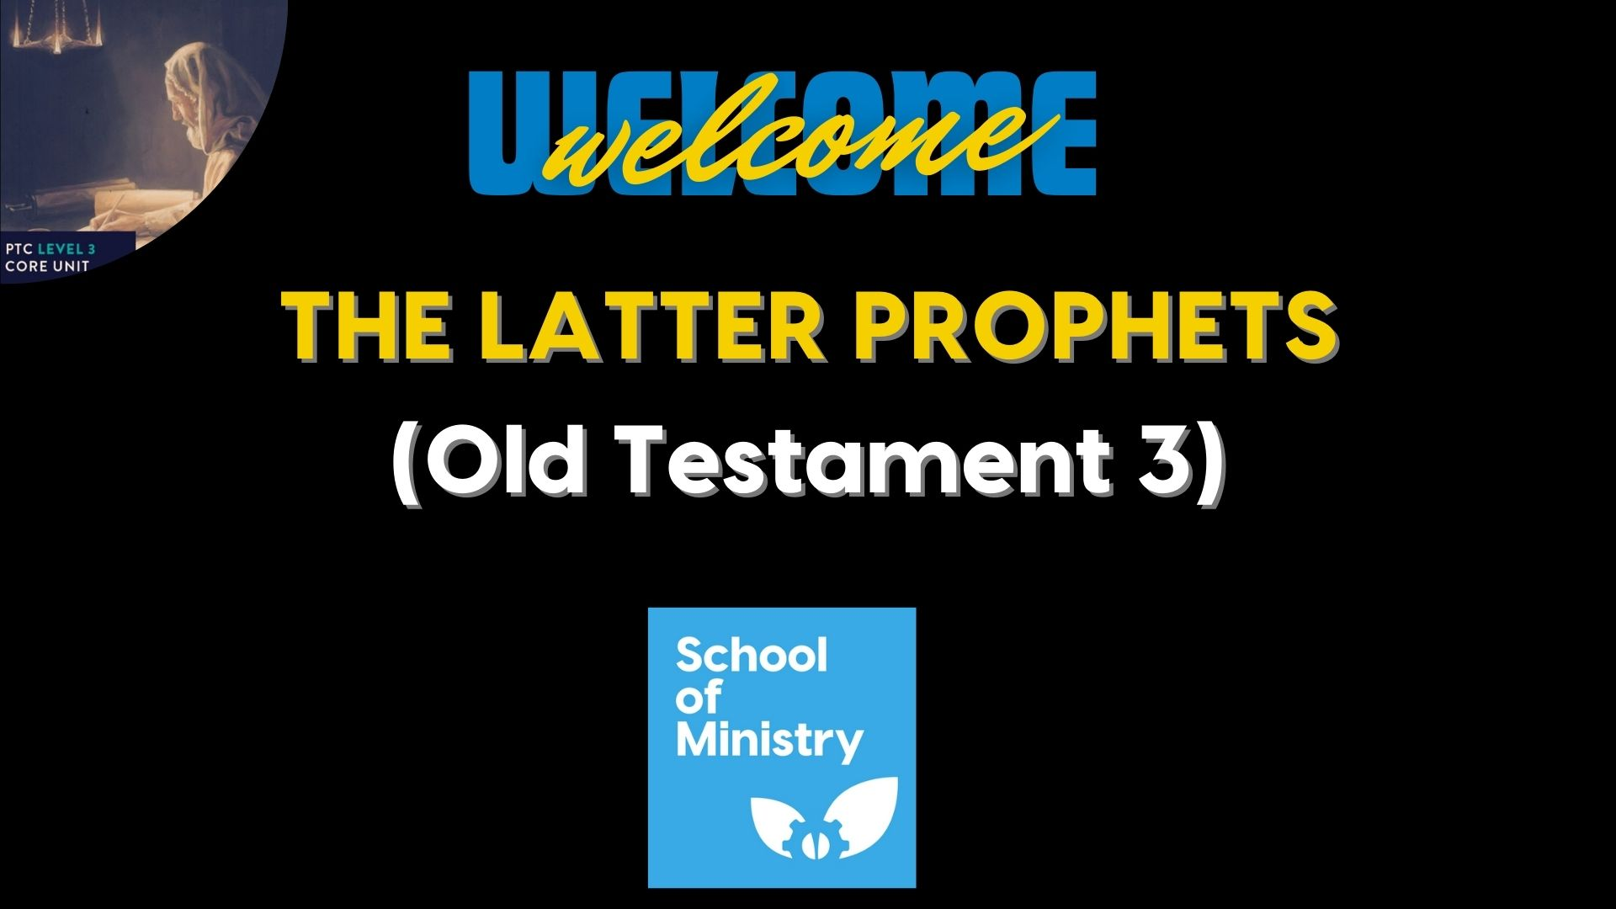

Slide 2
Study 7 – Ezekiel
Before we begin:
When we think about the instructions for churches in the New Testament, do you think the bible is specific in how we gather and worship, and in what we do together as we meet? Why or why not? Try to give theological reasons.

Slide 3
Study 7 – Ezekiel
Historical context
Ezekiel, the son of Buzi , was deported to Babylonia, almost certainly with Jehoiachin in 597 BC

Slide 4
Study 7 – Ezekiel
Structure and message of Ezekiel
See the two-bible project videos
  Ezekiel 1-33
  &
  Ezekiel 34-48

Slide 5
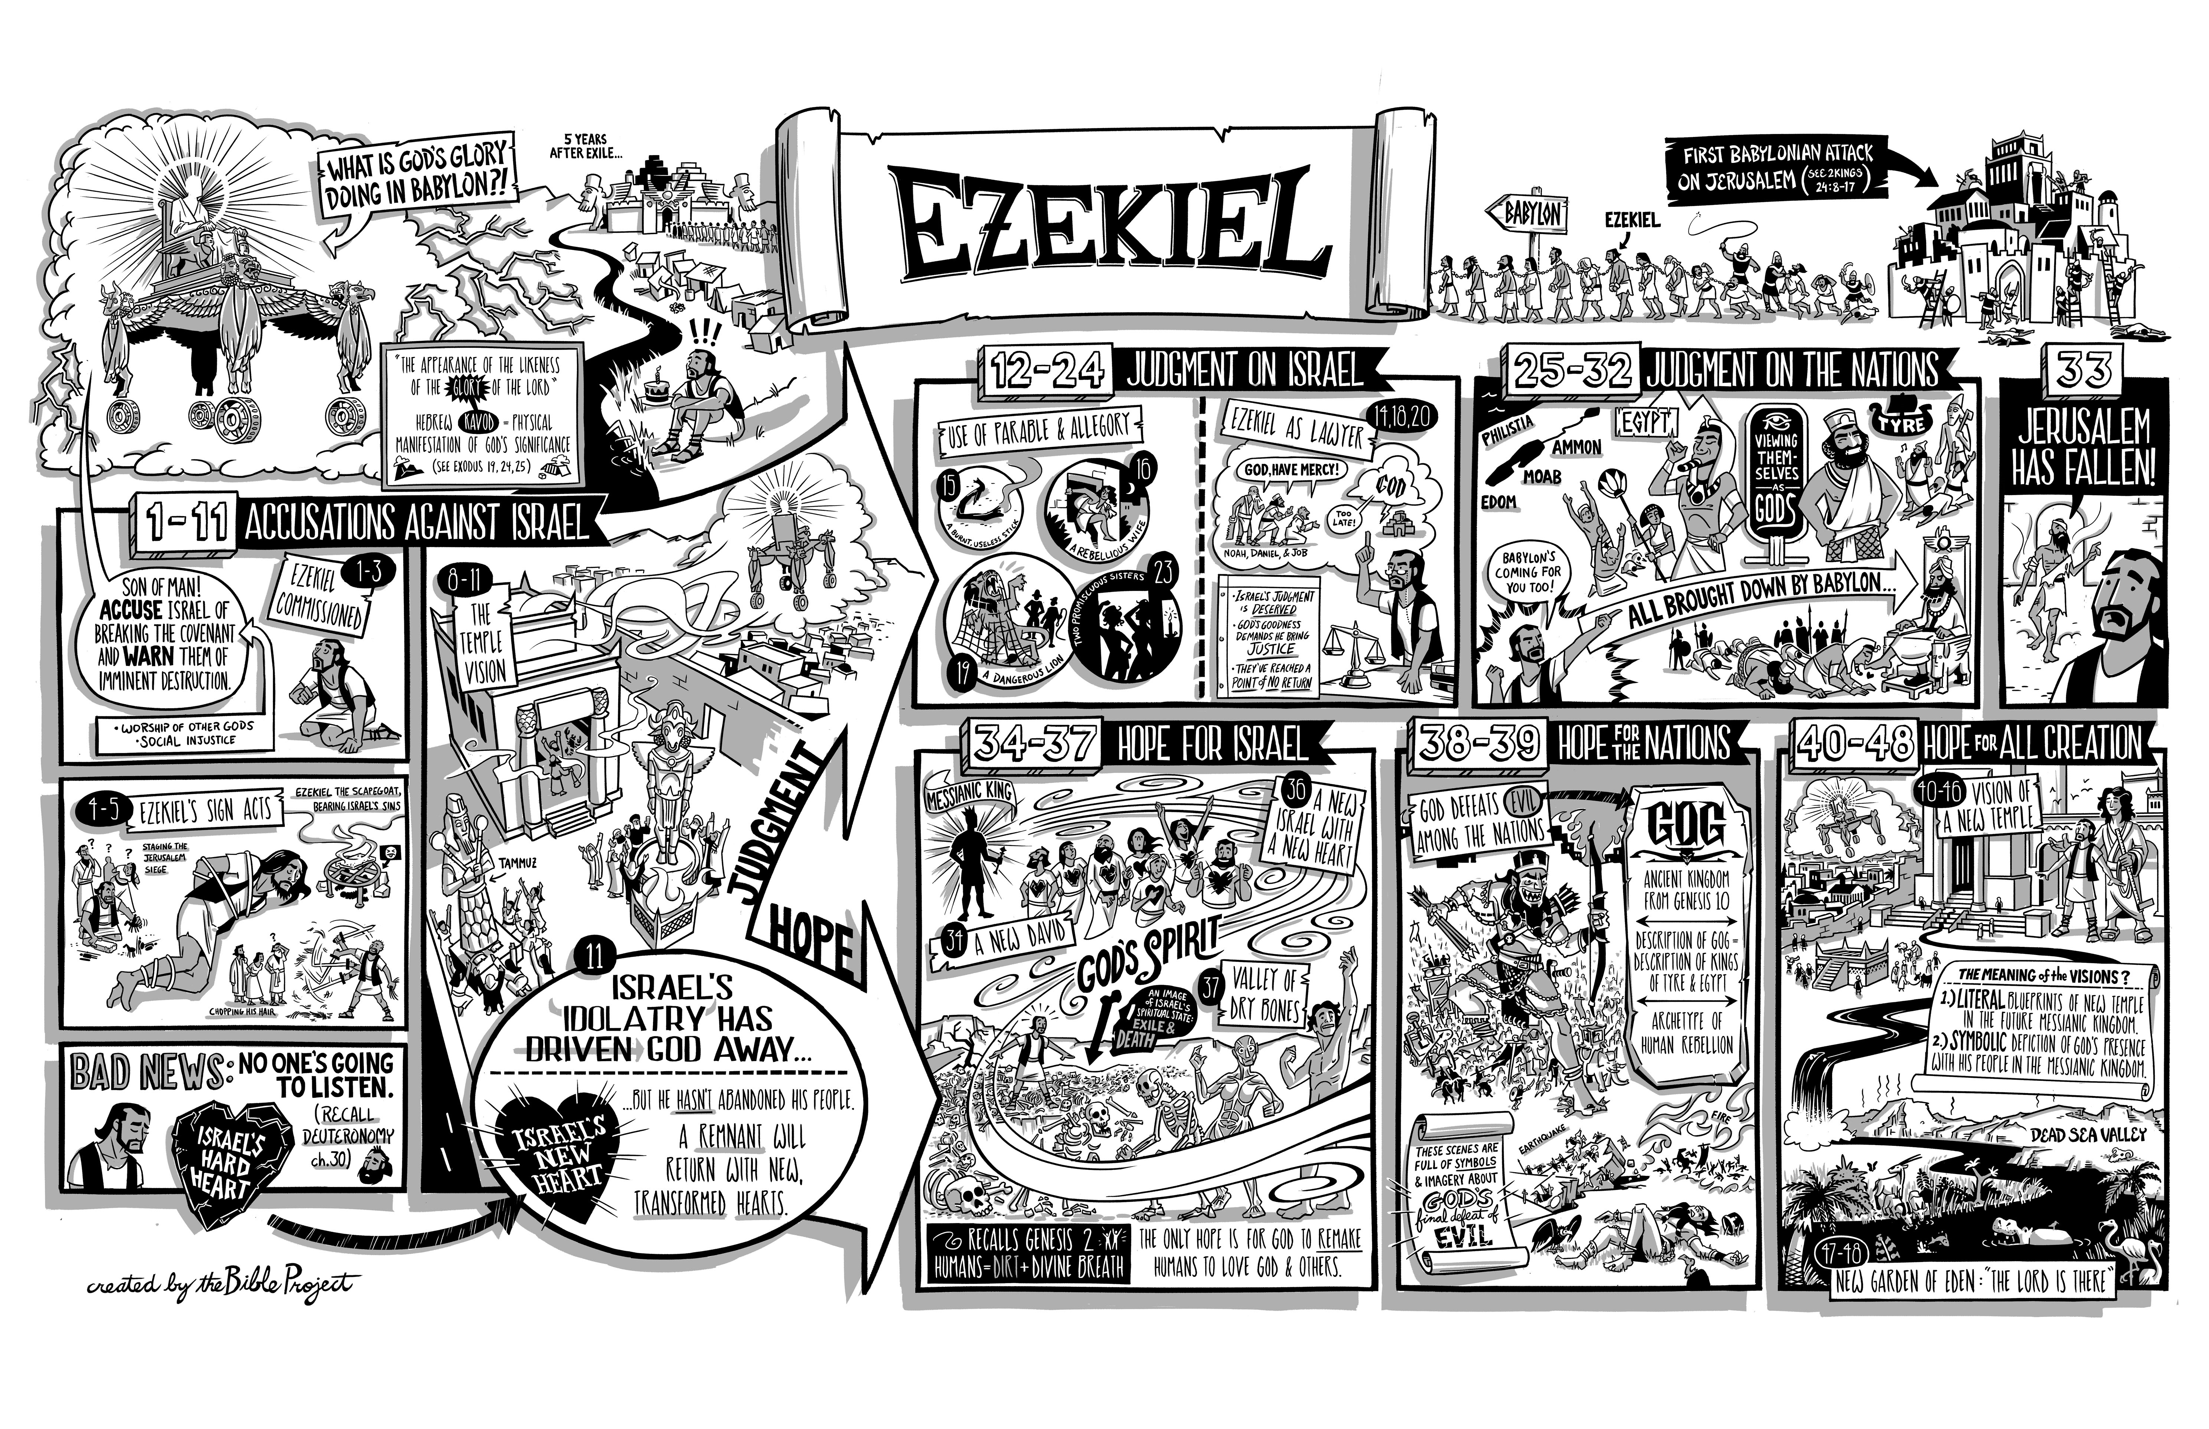
Study 7 – Ezekiel

Slide 6
Study 7 – Ezekiel
Exercise:
Read through the following passages –
Ezekiel 5:13 Ezekiel 6:6-7 & 9-10
Ezekiel 25:5 & 14 Ezekiel 29:8-9
What is the refrain that keeps emerging in these passages?
What does it say about God’s reason or purpose for his actions?
How does the refrain in Ezekiel relate to Exodus 6:6-9 and 7:4-5?
Does this refrain transform Ezekiel’s prophecies from being merely announcements of what God will do into announcements of God’s self-revelation?

Slide 7
Study 7 – Ezekiel
Some major Themes in Ezekiel
The name of God revealed in judgment and salvation
The Lord reveals himself in both judgement and in salvation
  See the previous examples in the exercise
  The name of the Lord has been profaned through Israel’s rebellion against the covenant

Slide 8
Study 7 – Ezekiel
Some major Themes in Ezekiel
The covenant
It’s not surprising to see the covenant featured in Ezekiel’s writings
God recalls his covenant with Israel when he brought them out of Israel
The restoration oracles also speak in terms of the covenant
The covenant language is even modified to embrace the Davidic covenant

Slide 9
Study 7 – Ezekiel
Some major Themes in Ezekiel
The temple.
The temple forms the heart of Ezekiel’s prophecy
  The glory of the Lord departs the temple
  And returns later to the renewed temple

Slide 10
Study 7 – Ezekiel
Ezekiel’s Eschatology
Judgement
Judgment is focused on God’s absence and restoration on his presence.
Individual responsibility
Israel had a collective responsibility to keep the covenant
  But both Jeremiah and Ezekiel qualify this as they quote the following proverb

Slide 11
Study 7 – Ezekiel
Ezekiel’s Eschatology
Group focus
Notwithstanding this – there is a group (exiles) and national focus (both in terms of Israel and the nations).
  Seen expressed against the shepherd and the rulers

Slide 12
Study 7 – Ezekiel
Ezekiel’s Eschatology
Spiritual renewal
Just as exile was due to the sin and covenant breaking of Israel
  Returning to the land has to be more than simply coming back
  It has to involve renewal

Slide 13
Study 7 – Ezekiel
Ezekiel’s Eschatology
Spiritual warfare
Political and spiritual powers will oppose the coming of God’s reign on earth with all their might.
  See Ch 38-39 and the battles described against Gog.
  Are Gog and his nations symbolic of the people of the world who are arraigned against the people of God? (See Rev. 20:8 ).
  vision of the renewed temple ch 40-47 points back to the details of the Tabernacle in Exodus.
  The vision of the new temple points towards a new way to bring together a holy God and a sinful people.

Slide 14
Study 7 – Ezekiel
Exercise:
Read Ezekiel 47: 1-12.
Thinking back to our opening studies on Prophetic Eschatology, answer the following questions.
What is the shadow that informs (and has done so since Ch 40) the prophetic vision of Ezekiel?
Read John 4:1-15, Revelation 21:22 - 22:5, John 2:19-22, John 1:14.
How are the themes from Ezekiel taken up in these New Testament passages?
What Old Testament passages or images does Ezekiel’s eschatology develop?

Slide 15
Study 7 – Ezekiel
Discuss
How would you explain to someone (don’t assume a person of high biblical literacy!) why we do not need a literal temple in Jerusalem to the specification that Ezekiel provides in chapters 40-47?
Also, revisit the opening discussion. Would you adjust or strengthen your position in any way?

Slide 16
Study 7 – Ezekiel
Homework: Read the OT3 notes for study 7.
For the next meeting: Read through Hosea, Joel, Amos, Obadiah, and Jonah.

