Slide 1


Slide 2
Study 4 – Isaiah 1-39
Before we begin:
Does God judge Christians in the same way as he judged Israel in Isaiah’s time? When we see judgement-like events in our society can we legitimately describe them as God’s judgement on sin?

Slide 3
Study 4 – Isaiah 1-39
Structure
Do you have a structure for chapters 1-39?

Slide 4
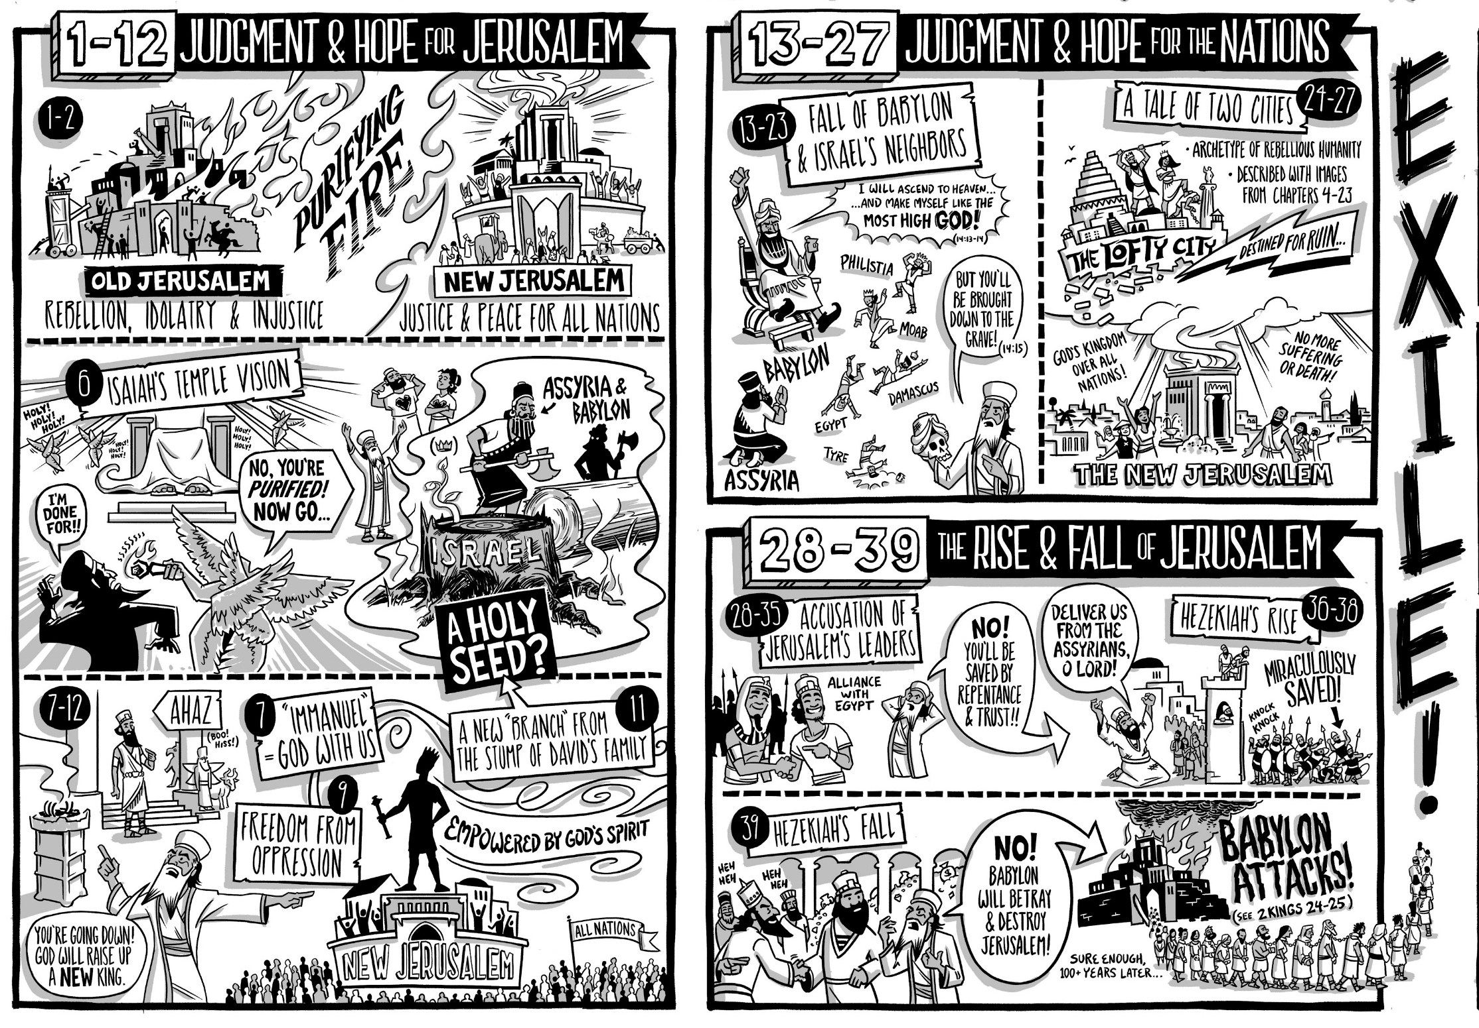

Slide 5
Study 4 – Isaiah 1-39
The overall message of Isaiah summaries in chapters 1-2
Exercise: Read together through Isaiah 1-2. As we read note down where we encounter the themes of Isaiah that we discussed last week.
God the Holy One of Israel
The Spirit of the Lord
Messiah
Judgment on Israel and Judah
Judgement and salvation for the nations
The Day of the Lord
Jerusalem (Zion)
The remnant
The Second Exodus
New Creation

Slide 6
Study 4 – Isaiah 1-39
Have a go at workshopping a summary statement of Isaiah 1-2.

Slide 7
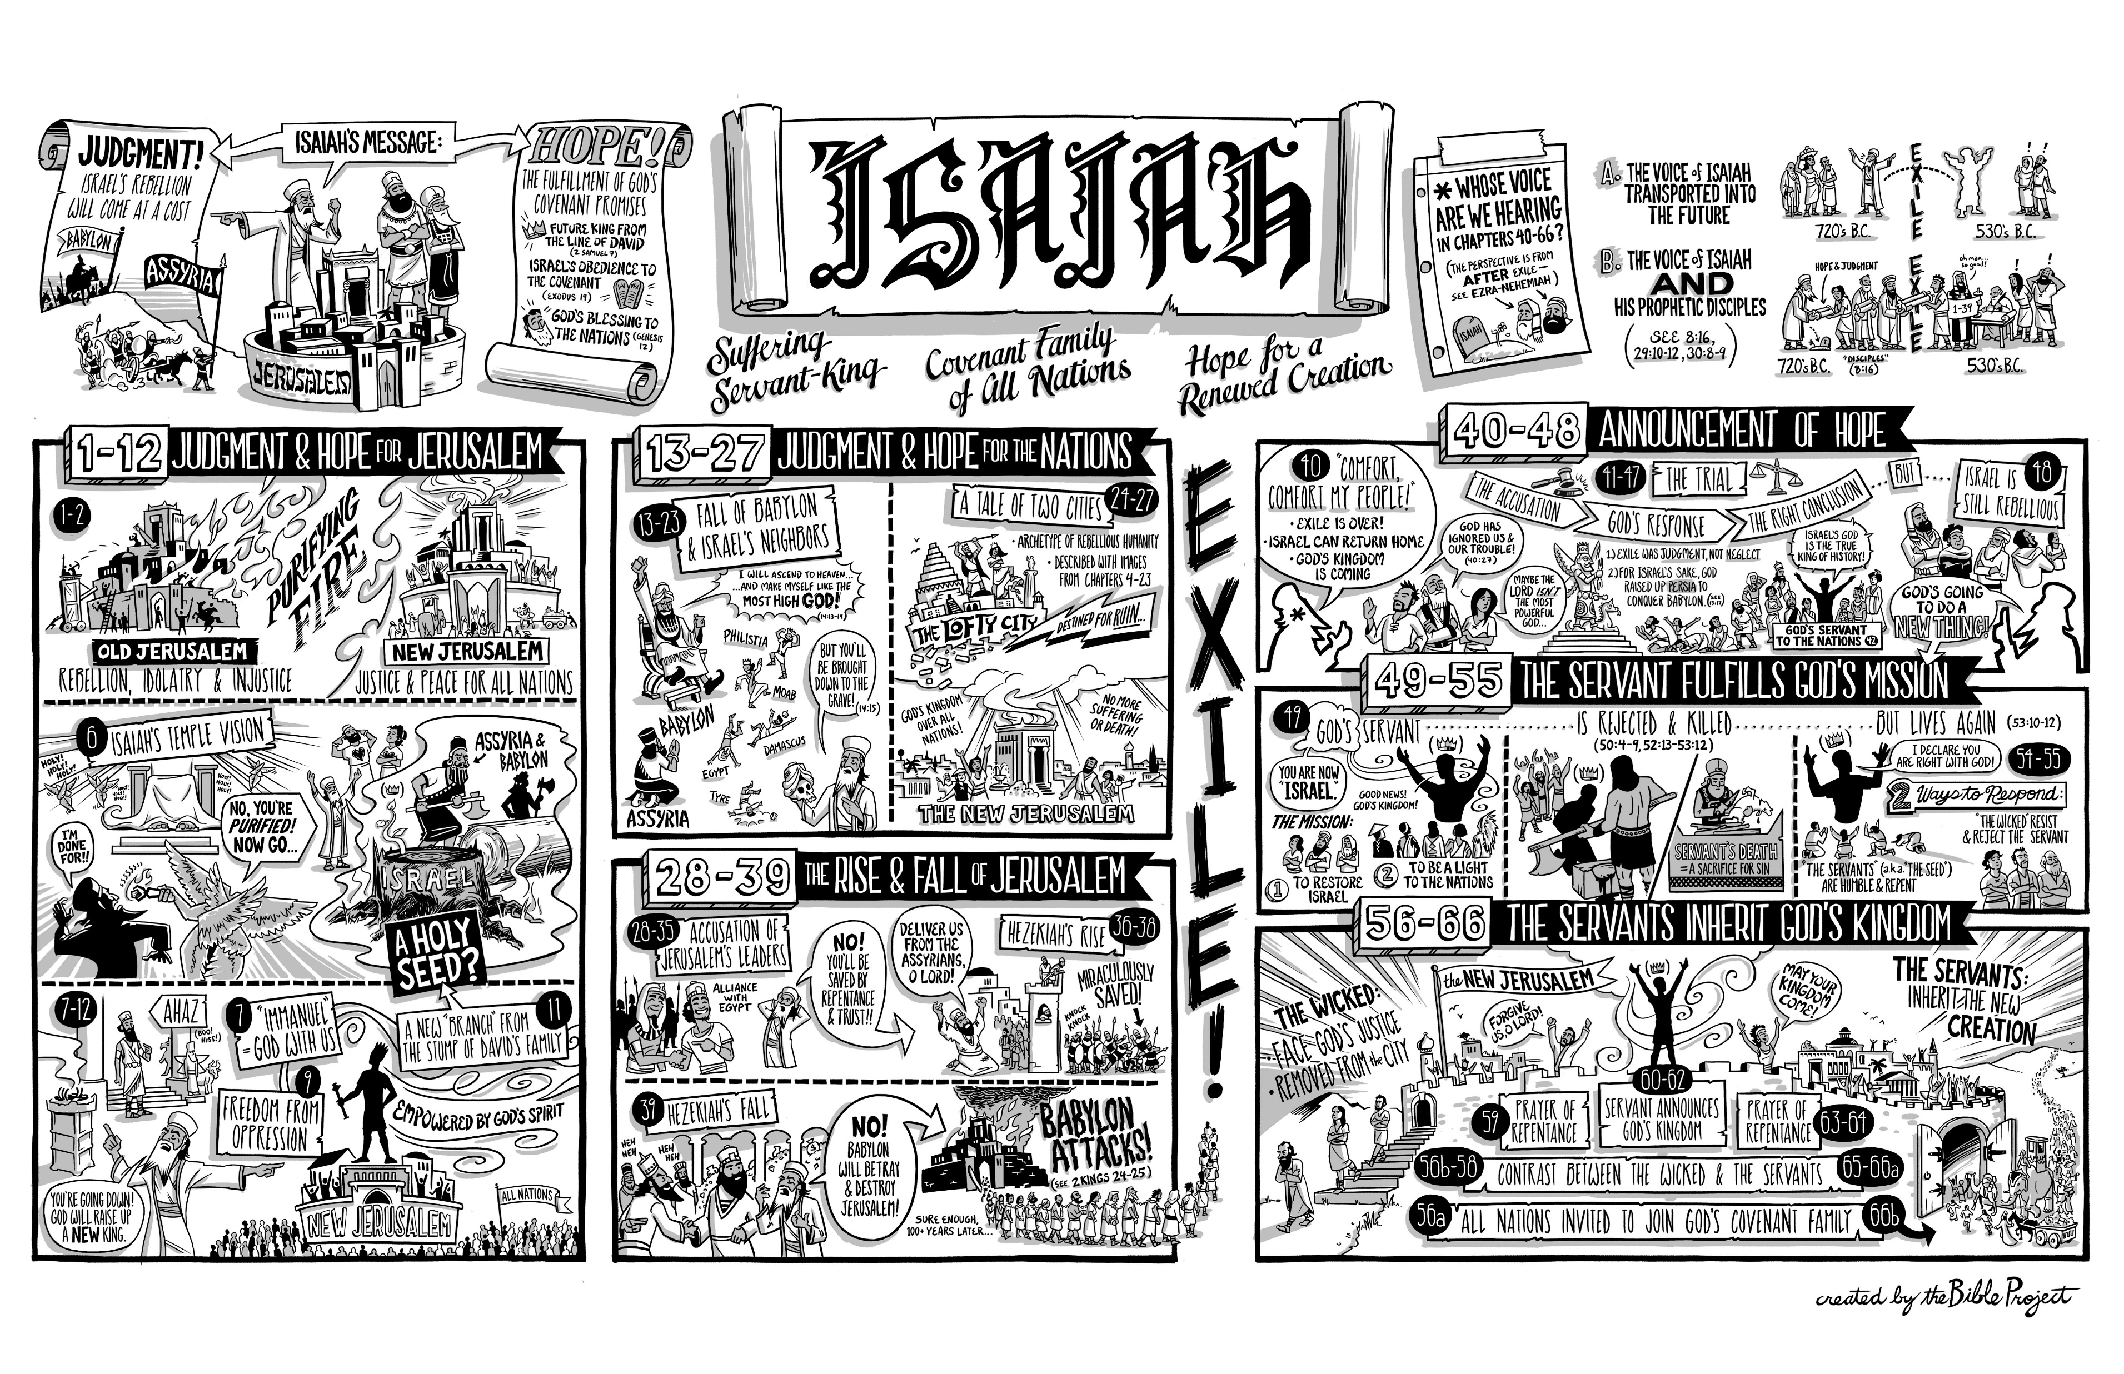
Study 4 – Isaiah 1-39
Isaiah’s call and the message of the Messiah King chapters 6-12

Slide 8
Study 4 – Isaiah 1-39

Slide 9

Study 4 – Isaiah 1-39

Slide 10
Study 4 – Isaiah 1-39

Slide 11
Study 4 – Isaiah 1-39

Slide 12
Study 4 – Isaiah 1-39

Slide 13
Study 4 – Isaiah 1-39

Slide 14
Study 4 – Isaiah 1-39
Exercise: As a group, take turns reading the chapters of Isaiah 36-39 aloud.
As it is read, pause to note down the themes we recognise as we go along.
God the Holy One of Israel
The Spirit of the Lord
Messiah
Judgment on Israel and Judah
Judgement and salvation for the nations
The Day of the Lord
Jerusalem (Zion)
The remnant
The Second Exodus
New Creation

Slide 15
Study 4 – Isaiah 1-39
After reading, discuss the following questions:
What do you think is the main concern of Isaiah as we read these chapters? That is, considering the structure of Isaiah, why do you think they are included here?
Why do you think Hezekiah responded the way he did in Isaiah 39:8?
As a reader of Isaiah, what themes and ideas has chapters 1-35 already provided as a way for you to understand these chapters? What do we understand as the possible future for the people of God?

Slide 16
Study 4 – Isaiah 1-39
Homework – Read the NBD article on Isaiah located in the drive folder “Handouts”
Next meeting – March 24th.

Slide 17
Study 4 – Isaiah 1-39

