Slide 1

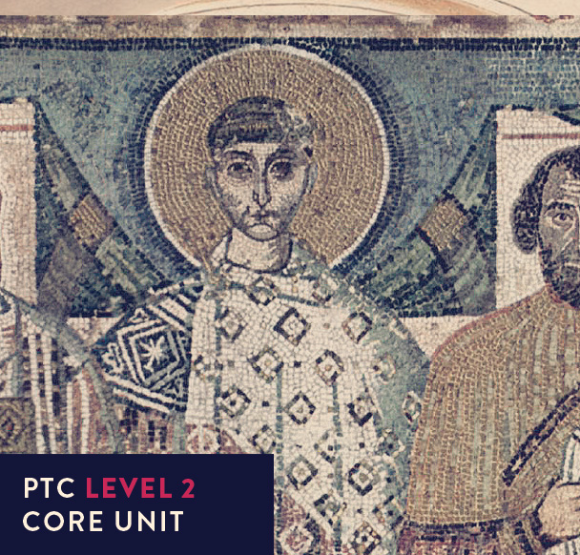
Early Church History

Slide 2



UNIT 9
THE ROAD TO CHALCEDON: Christological controversies

Slide 3

A ‘fun’ quiz for your enjoyment

Slide 4

Who AM I?
He was born in Antioch in the fourth century and brought up by his widowed Christian mother.
He lived for some years in a cave outside Antioch which damaged his health.
He was made presbyter in Antioch and was much admired for his excellence as a preacher and orator.
In 397 he was 'forced' to accept the position of bishop of Constantinople, creating much jealousy among his colleagues.
Unlike his enemies, he was totally without guile and preached fearlessly, but during a distant exile died in 407.

Slide 5
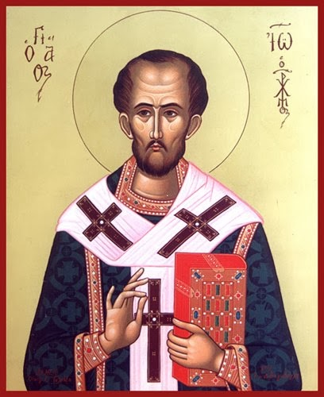
Who AM I?
He was born in Antioch in the fourth century and brought up by his widowed Christian mother.
He lived for some years in a cave outside Antioch which damaged his health.
He was made presbyter in Antioch and was much admired for his excellence as a preacher and orator.
In 397 he was 'forced' to accept the position of bishop of Constantinople, creating much jealousy among his colleagues.
Unlike his enemies, he was totally without guile and preached fearlessly, but during a distant exile died in 407.
John Chrysostom
This Photo by Unknown Author is licensed under CC BY-NC-ND

Slide 6
Who AM I?
He was born in 256 (?) probably in Libya and was made a presbyter in Alexandria in 313 after studying in Antioch.
After a bishops' council in 320 he was excommunicated by the bishop of Alexandria for stating heretical views, though he had plenty of supporters including Eusebius of Nicomedia.
His name is given to a particular heresy which still has supporters today.

Slide 7
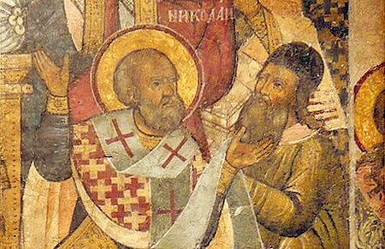
Who AM I?
He was born in 256 (?) probably in Libya and was made a presbyter in Alexandria in 313 after studying in Antioch.
After a bishops' council in 320 he was excommunicated by the bishop of Alexandria for stating heretical views, though he had plenty of supporters including Eusebius of Nicomedia.
His name is given to a particular heresy which still has supporters today.
Arius
This Photo by Unknown Author is licensed under CC BY-SA

Slide 8
Who AM I?
Born in about 330 to a wealthy Christian family, he studied in Athens, taught rhetoric, was baptised and then pursued a monastic life.
He was appointed presbyter (364), then bishop of Caesarea.
He devoted himself to social schemes for the poor and the fight against Arianism.
He died in 379.

Slide 9
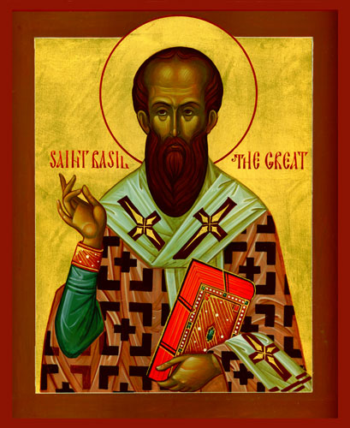
Who AM I?
Born in about 330 to a wealthy Christian family, he studied in Athens, taught rhetoric, was baptised and then pursued a monastic life.
He was appointed presbyter (364), then bishop of Caesarea.
He devoted himself to social schemes for the poor and the fight against Arianism.
He died in 379.
Basil
This Photo by Unknown Author is licensed under CC BY

Slide 10
Who AM I?
A silver statue of this person, dressed in a long robe was erected close to the church in Constantinople in 403.
John, the bishop, regarded this as an insult and used his 'golden tongue' to condemn this, using abuse and ridicule to great effect.
Accused of a personal attack, John delivered a particularly famous oration.

Slide 11
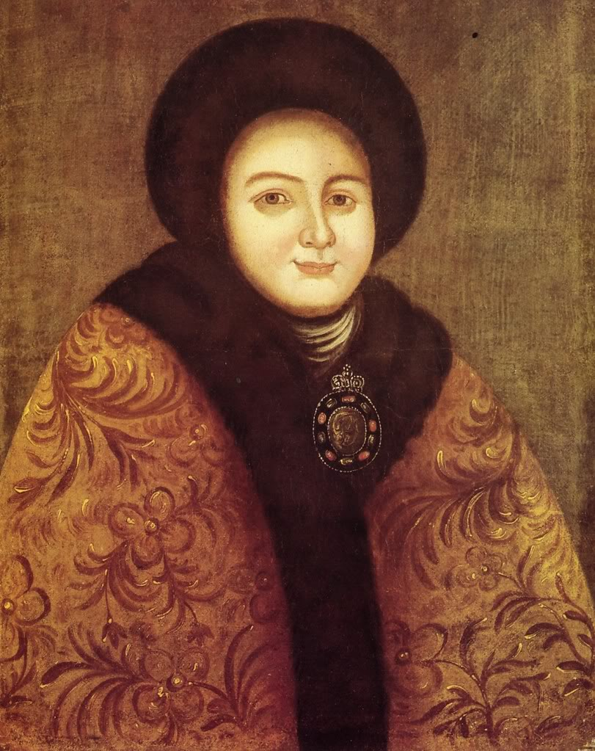
Who AM I?
A silver statue of this person, dressed in a long robe was erected close to the church in Constantinople in 403.
John, the bishop, regarded this as an insult and used his 'golden tongue' to condemn this, using abuse and ridicule to great effect.
Accused of a personal attack, John delivered a particularly famous oration.
Empress Eudoxia
This Photo by Unknown Author is licensed under CC BY-NC-ND

Slide 12
Who AM I?
He was born in Numidia in 354, moved to Carthage for his later education, had a son out of wedlock and became professor of rhetoric in Milan in 384.
Strongly influenced by Ambrose he eventually found in Christ the answer to his strong sense of sinfulness after reading Romans 13:13-14.
He was baptised in 387 much to the delight of his praying Christian mother.
Arguably the greatest Christian theologian after the Apostle Paul, he emphasised the need for salvation by grace.
He died in 430 as the Vandals besieged the city where he had been bishop since 396.

Slide 13
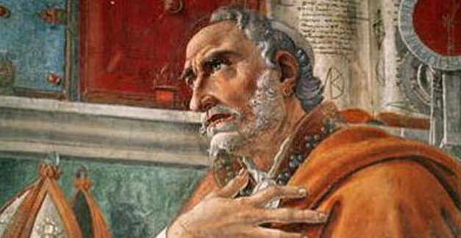
Who AM I?
He was born in Numidia in 354, moved to Carthage for his later education, had a son out of wedlock and became professor of rhetoric in Milan in 384.
Strongly influenced by Ambrose he eventually found in Christ the answer to his strong sense of sinfulness after reading Romans 13:13-14.
He was baptised in 387 much to the delight of his praying Christian mother.
Arguably the greatest Christian theologian after the Apostle Paul, he emphasised the need for salvation by grace.
He died in 430 as the Vandals besieged the city where he had been bishop since 396.
Augustine
This Photo by Unknown Author is licensed under CC BY

Slide 14


Who said this?
“Not in rioting and drunkenness, not in chambering and wantonness, not in strife and envying; but put ye on the Lord Jesus Christ, and make not provision for the flesh ... I wished to read no further; nor did I need; for instantly at the end of this sentence, by a light as it were of serenity infused into my heart, all the darkness of doubt vanished.”

Slide 15
Who said this?
“Not in rioting and drunkenness, not in chambering and wantonness, not in strife and envying; but put ye on the Lord Jesus Christ, and make not provision for the flesh ... I wished to read no further; nor did I need; for instantly at the end of this sentence, by a light as it were of serenity infused into my heart, all the darkness of doubt vanished.”
Augustine
This Photo by Unknown Author is licensed under CC BY

Slide 16
Who said this?
“For neither is the Son Father, for the Father is One, but he is what the Father is; nor is the Spirit Son because he is of God, for the only-begotten is One, but he is what the Son is. The Three are One in Godhead, and the One Three in properties; so that neither is the unity a Sabellian one, nor do the Three countenance the present evil division.
What then? Is the Spirit God? Most certainly. Well then, is he consubstantial? Yes, if he is God!”

Slide 17
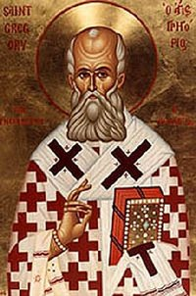
Who said this?
“For neither is the Son Father, for the Father is One, but he is what the Father is; nor is the Spirit Son because he is of God, for the only-begotten is One, but he is what the Son is. The Three are One in Godhead, and the One Three in properties; so that neither is the unity a Sabellian one, nor do the Three countenance the present evil division.
What then? Is the Spirit God? Most certainly. Well then, is he consubstantial? Yes, if he is God!”
Gregory of Nazianzus
This Photo by Unknown Author is licensed under CC BY

Slide 18
Who said this?
“… the Latin manuscripts of the Scriptures are proved to be faulty by the variations which all of them exhibit, and my object has been to restore them to the form of the Greek original...”

Slide 19
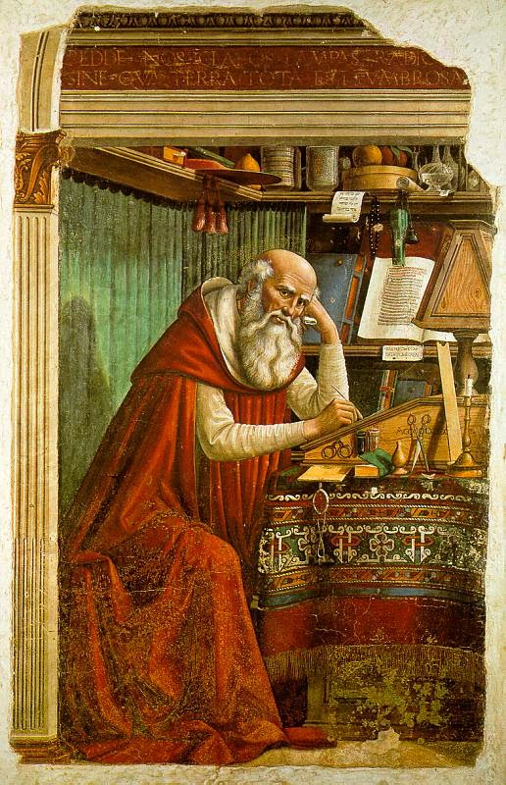
Who said this?
“… the Latin manuscripts of the Scriptures are proved to be faulty by the variations which all of them exhibit, and my object has been to restore them to the form of the Greek original...”
Jerome
This Photo by Unknown Author is licensed under CC BY-NC-ND

Slide 20
Who said this?
“You write, beloved and truly longed for, yourself also in distress, that certain persons, having forsaken the Arians on account of their blasphemy against the Son of God, yet oppose the Holy Spirit, saying that he is not only a creature, but actually one of the ministering spirits, and differs from the angels only in degree.”

Slide 21
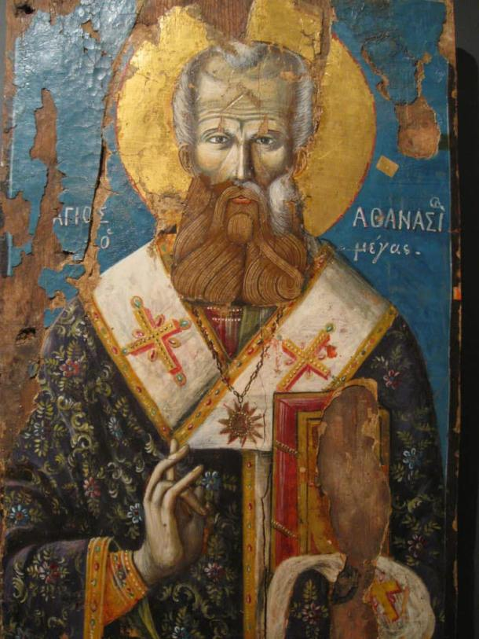
Who said this?
“You write, beloved and truly longed for, yourself also in distress, that certain persons, having forsaken the Arians on account of their blasphemy against the Son of God, yet oppose the Holy Spirit, saying that he is not only a creature, but actually one of the ministering spirits, and differs from the angels only in degree.”
Athanasius
This Photo by Unknown Author is licensed under CC BY-NC-ND

Slide 22
Who said this?
“'We pay to Caesar what is Caesar's, and to God what is God's.' Tribute is due to Caesar; we do not deny it. The Church belongs to God, therefore it ought not to be assigned to Caesar. For the temple of God cannot be Caesar's by right.”

Slide 23
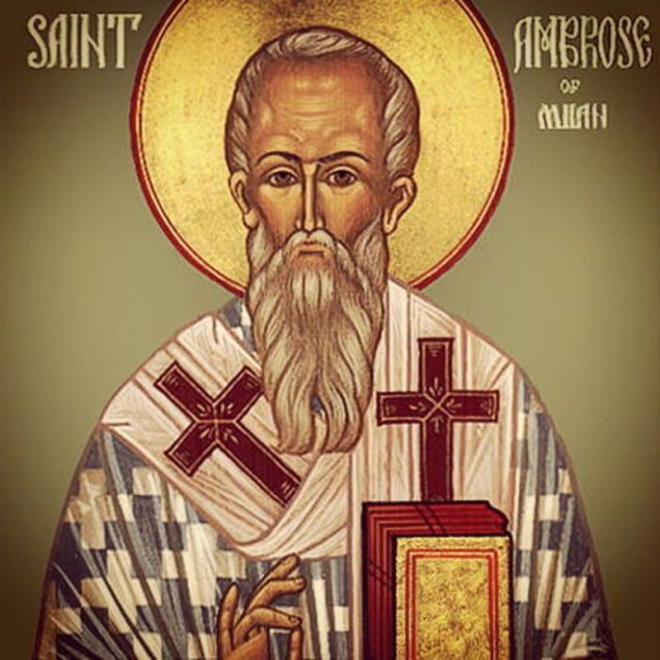
Who said this?
“'We pay to Caesar what is Caesar's, and to God what is God's.' Tribute is due to Caesar; we do not deny it. The Church belongs to God, therefore it ought not to be assigned to Caesar. For the temple of God cannot be Caesar's by right.”
Ambrose
This Photo by Unknown Author is licensed under CC BY-SA

Slide 24
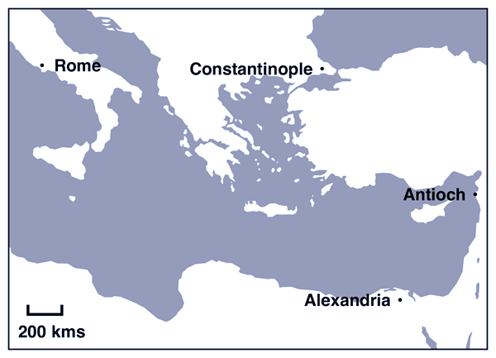
Rivalry of the great sees

Slide 25
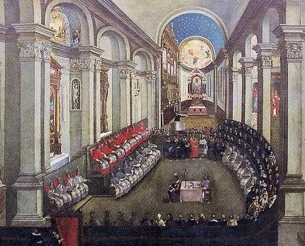
The Council of Chalcedon
This took place in 451, called by the Emperor Marcian to solve the problem of Eutyches, an ageing and well-respected monk from Constantinople.
However, as you might have guessed, the problem was far more complex than one, possibly confused, elderly monk and had been around for many years.
There is a real danger that we also will find this confusing, so we'll look at some ecclesiastical history in the hope of gaining a better understanding.
This Photo by Unknown Author is licensed under CC BY-SA

Slide 26
The Council of Chalcedon: two things first
When the previous emperor Theodosius II died (he fell from his horse) in 450 he was succeeded by his sister Pulcheria. She took an eminent soldier, Marcian, as her husband and the two reigned jointly. It was Pulcheria's commissioners who controlled the proceedings at Chalcedon.
Chalcedon was across the Bosphorous from the main city of Constantinople.
This Photo by Unknown Author is licensed under CC BY-SA

Slide 27
The Council of Chalcedon: and now…
There was the question of the relationship between the two natures (divine and human) of Jesus Christ. Although discussed at a synod in Alexandria in 362, it remained a minor issue, particularly as the Son was generally viewed as inferior to the Father.
This Photo by Unknown Author is licensed under CC BY-SA

Slide 28
The Council of Chalcedon: and now…
There was the question of the relationship between the two natures (divine and human) of Jesus Christ. Although discussed at a synod in Alexandria in 362, it remained a minor issue, particularly as the Son was generally viewed as inferior to the Father.
The Antioch School stressed the humanity of Christ; they regarded the human nature as body and soul united. Jesus' experience of hunger and pain might be ascribed to the flesh alone but not his emotional life (e.g., sorrow, compassion). After the Word became flesh (John 1:14) the two natures remained distinct. The problem was that this started to look like two beings (Son of God – Son of Mary) joined but not united in one person. This dualistic approach meant that whatever Jesus did could be assigned either to his divine or human nature.
This Photo by Unknown Author is licensed under CC BY-SA

Slide 29
The Council of Chalcedon: and now…
Apollinarius, Bishop of Laodicaea, disagreed.
He denied that Christ had a human soul; surely the soul is corrupt so couldn't possibly motivate a Saviour to die for sinful humanity. Christ, he said, was 'one nature composed of impassable divinity and passible flesh.' Christ's flesh took on a divine character.
This teaching started to draw lots of attention in the 370's when the bishop of Salamis (Epiphanius) denounced it.
Apollinarius' view of Christ's incarnation seemed to diminish his humanity, was condemned at the Council of Constantinople in 381 and outlawed in 388.
This Photo by Unknown Author is licensed under CC BY-SA

Slide 30
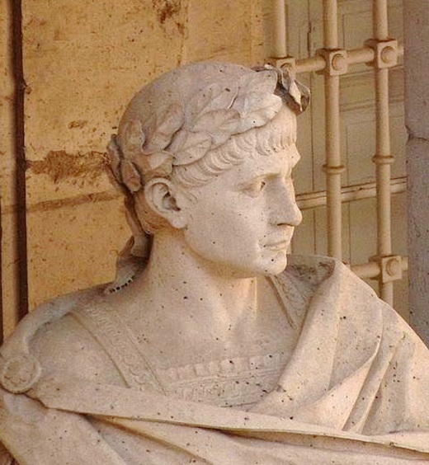
“We command that the Apollinarians and all other followers of diverse heresies shall be prohibited from all places, from the walls of the cities, from the congregation of honourable men, from the communion of the saints…”
(Theodosius I, Valentinium II & Gratian)
This Photo by Unknown Author is licensed under CC BY-SA

Slide 31
The Council of Chalcedon: and now…
So, we come to Nestorius a preacher at Antioch before becoming Bishop of Constantinople in 428.
He belonged to the 'Antiochene' school and regarded Jesus as the man indwelt by the Word.
Despite Nestorius' attempts to unite them, they seemed to remain two individuals (Jesus – the man, God the Word) united in purpose.
He denied in his teaching that Mary was God-bearer (Theotokos); Mary's son was the man Jesus not God the Word, “I could not call a baby two or three months old God.”
This Photo by Unknown Author is licensed under CC BY-SA

Slide 32
The Council of Chalcedon: and now…
Enter Cyril, Bishop of Alexandria from 412 who wrote Nestorius a polite, but firm, letter demanding that he signed 'anathemas' condemning his heresies. When Nestorius refused, the emperor (Theodosius II) called the Council of Ephesus which met in 431.
Cyril's position was quite straightforward: The Word, eternally begotten of the Father was born as a man to the virgin Mary (Mary, therefore, is 'theotokos'). Christ is not two persons united in purpose, he is the Word who took on flesh, i.e., the doctrine of the incarnation.
This Photo by Unknown Author is licensed under CC BY-SA

Slide 33
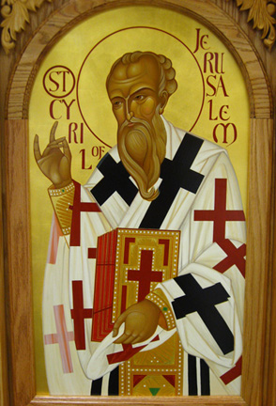
“Confessing then the personal union of the Word with the flesh, we worship one Son and Lord, Jesus Christ, neither putting apart and sundering man and God ... but knowing only one Christ, the Word which is of God the Father with his own flesh. For then (i.e., when he took on flesh) he was anointed with us as man.”
(Cyril, Letter 3 to Nestorius)
This Photo by Unknown Author is licensed under CC BY

Slide 34
The Council of Chalcedon: and now…
At The Council of Ephesus Cyril got Nestorius deposed before his supporters turned up late from Syria. John of Antioch condemned Cyril but the Roman delegation arrived at last and approved Cyril's action.
The outcome was division, and some confusion, Alexandria and Antioch were at loggerheads. A sort of settlement was reached in 433 when the Syrians produced a document ‘The Formula of Reason’. It stated the doctrine of the incarnation, and they accepted Nestorius' deposition; it was a compromise that held while Cyril (Bishop of Alexandria) and John of Antioch were alive but did not satisfy the extremists.
This Photo by Unknown Author is licensed under CC BY-SA

Slide 35
The Council of Chalcedon: and now…
A new set of leaders were in place by the mid 440s.
      John of Antioch died in 441/2 and Cyril in 444.
    Leo I became bishop in Rome in 440,
    Dioscorus succeeded Cyril in 444 and
    Flavian became bishop of Constantinople in 446.
This Photo by Unknown Author is licensed under CC BY-SA

Slide 36
The Council of Chalcedon: and now…
Theodoret remained of the old protagonists. He was bishop of Cyrus, about 80kms from Antioch.
Earlier in his ministry he supported Nestorius, misunderstanding Cyril and writing against him.
He thought Cyril believed Christ suffered as God in his deity [WRONG!]. In fact Cyril was convinced that the Word is incapable of suffering as God, while as a man he suffered for us.
Later, he suggested a middle course between (a) Jesus Christ being divided into two persons and (b) having two natures (deity and humanity) in one person.
This Photo by Unknown Author is licensed under CC BY-SA

Slide 37
The Council of Chalcedon: and now…
And so, we get to Eutyches, the aged monastic superior in Constantinople who attacked the two natures/one person idea and was teaching a 'one nature' doctrine – that Jesus' humanity was absorbed by his divinity, as a drop of wine in the ocean!
Although both Theodoret and Flavian condemned him, he was supported by the domineering and unprincipled Dioscorus, leading to charges and countercharges, intrigue and disorder … so the emperor (Theodosius II) called another council in Ephesus in 449.
This Photo by Unknown Author is licensed under CC BY-SA

Slide 38
The Council of Chalcedon: and now…
The council was labelled a 'robber band' by Leo and has since been called the Robber Synod. Dioscorus dominated proceedings, Leo's 'Tome' (against Eutyches and stating that in order to save us Jesus had to be both God and man) was not allowed to be read, Theodoret was excommunicated and Eutyches restored. Flavian was deposed and died a few days later as a result of his treatment. The 'Formula of Reason' and its two-nature doctrine was banned.
This Photo by Unknown Author is licensed under CC BY-SA

Slide 39
The Council of Chalcedon: and now…
This was a dire situation for the church with no redress, until Theodosius II fell off his horse the next year and was succeeded by his wife Pulcheria and her new husband Marcian.
So, the Council of Chalcedon was called in 451. Pulcheria was sympathetic to Leo and Flavian's cause and thankfully much was put right.
This Photo by Unknown Author is licensed under CC BY-SA

Slide 40
The Council of Chalcedon: and now…
The Antiochene bishops were reinstated.
Eutyches and Dioscorus were deposed.
The creeds of Nicaea and Constantinople were read and approved.
Cyril's letters (contra Nestorius) were read and approved.
Leo's Tome was accepted (contra Eutyches)
  the bishops' response to this was to shout, “Peter has spoken through Leo. Thus, Cyril taught, Leo and Cyril teach the same.”
The Chalcedonian Definition (student manual pp 176-7) was accepted in the West but not in the East and particularly not in Egypt.
This Photo by Unknown Author is licensed under CC BY-SA

Slide 41
The Council of Chalcedon: and now…
The Chalcedonian Definition answers each of the four ancient heresies which are:
        True deity (against A_______________)
        Full humanity (against A____________________)
        United in one person (against N_____________________)
        But not confused (against E________________)
This Photo by Unknown Author is licensed under CC BY-SA

Slide 42
Reflection / Question over coffee
"How could God die on a cross?”
How would you answer this question to someone who is not yet a Christian?
Early Church History

