Slide 1

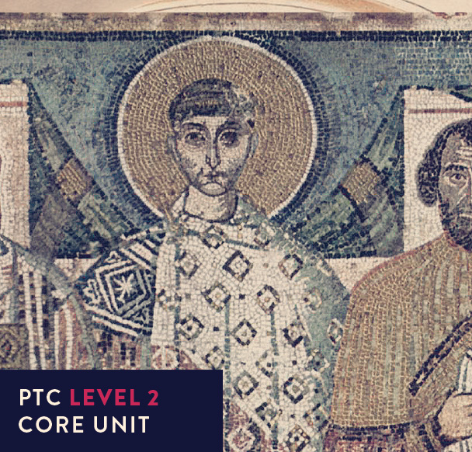
Early Church History

Slide 2


UNIT 7
Trinitarian controversies
The Father
The Son
IS NOT
IS
IS
GOD
IS NOT
IS NOT
IS
The Spirit

Slide 3
How would you explain the Trinity?

Slide 4
Some background
God is Creator

Slide 5
Some background
God is Creator
The Creator entered fully into human life (John 1:1-14)

Slide 6
Some background
God is Creator
The Creator entered fully into human life (John 1:1-14)
Jesus was flesh and blood (1 John 4:2; 2 John 7)

Slide 7
Some background
God is Creator
The Creator entered fully into human life (John 1:1-14)
Jesus was flesh and blood (1 John 4:2; 2 John 7)
Was the Son generated by the Father?

Slide 8
Some background
God is Creator
The Creator entered fully into human life (John 1:1-14)
Jesus was flesh and blood (1 John 4:2; 2 John 7)
Was the Son generated by the Father?
Can we say, 'The Lord our God is one' + 'Jesus is Lord'?

Slide 9
Some background
God is Creator
The Creator entered fully into human life (John 1:1-14)
Jesus was flesh and blood (1 John 4:2; 2 John 7)
Was the Son generated by the Father?
Can we say, 'The Lord our God is one' + 'Jesus is Lord'?
Does God exist in different modes? (Sabellianism)

Slide 10
Some background
God is one being (substantia) but three distinct individuals (personae)
Tertullian

Slide 11
Some background
Father, Son, Spirit 3 persons (hypostases), the Son is inferior to the Father – the Spirit subordinate to both.
Origen

Slide 12
Some background
Before the Council of Nicaea all theologians appeared to view the Son as subordinate to the Father.

Slide 13
Some background
Before the Council of Nicaea all theologians appeared to view the Son as subordinate to the Father.
In the West:
strong on the unity of the God, weak on the distinctiveness of the three.
In the East:
weak on the unity of the God, strong on the distinctiveness of the three.

Slide 14
Some background
Creeds and Rules of Faith often reflected local or personal concerns:
e.g., Tertullian – 'the Holy Spirit, the Paraclete, the Sanctifier of the faith of those who believe in the Father, the Son and the Holy Spirit'.

Slide 15
The Council of Nicaea (325AD)
We know very little about the proceedings.
Emperor Constantine himself presided at the opening session. Of about 220 bishops present nearly all were from the east.

Slide 16
The Council of Nicaea (325AD)
The Council produced its own creed to exclude Arian heresy; we call it the Creed of Nicaea to distinguish it from the Nicene Creed:

Slide 17
The Council of Nicaea (325AD)
“We believe in one God, the Father, Almighty, maker of all things visible and invisible;
And in one Lord Jesus Christ, the Son of God, begotten of the Father, only begotten, that is, from the substance (ousia) of the Father; God from God, Light from Light, Very God from Very God, begotten not made, of one substance (homoousios, consubstantial) with the Father, through whom all things were made, both in heaven and on earth; who for us men and for our salvation came down and was incarnate, was made man, suffered, and rose again on the third day, ascended into heaven, and is coming to judge the living and the dead;
And in the Holy Spirit.”

Slide 18
The Council of Nicaea (325AD)
And those who say: “There was a time when he was not,” and: “Before he was begotten he was not”, and “He came into being from nothing”, or those who pretend that the Son of God is “Of another substance (hypostasis), or essence (ousia)” [than the Father] or “created” or “mutable”, the catholic and apostolic church places under a curse.

Slide 19


Arius
Presbyter of a church in Alexandria
c. 318 AD challenges teachers in Alexandria – asserts that the Word who became flesh (John I:14) was not true God
Jesus Christ, he asserted, had an entirely different nature, neither eternal nor omnipotent

Slide 20
Arius
Therefore, when Christians called Christ ‘God’ they did not mean he was deity – except in an approximate sense.
He is then a lesser being, a created being – the first and greatest but created.
Arius writes to the bishop at Nicomedia: “The Son has a beginning but ... God is without beginning.”

Slide 21
Arius
Alexander, bishop of Alexandria, calls a synod (AD 320), Arius is condemned and excommunicated.
Arius wins the backing of his friend Eusebius, bishop of Nicomedia .
The two most important churches in the East (Nicomedia and Alexandria) are now in conflict.

Slide 22
Arius
However, Arianism did not die, and even flourished in parts of the empire.

Slide 23

The Cappadocian fathers
Basil of Caesarea
Gregory of Nazianzus
Gregory of Nyssa
From the Roman province of Cappadocia

Slide 24
The Cappadocian fathers
Basil – born about 330 into a wealthy Christian family, well-educated, studied in Athens from 351, met Gregory of Nazianzus.
On returning home taught rhetoric, was baptised and led a monastic life. Set up his own monastic community, was appointed presbyter (364) then bishop (370) at Caesarea. He devoted himself to social schemes for the poor and the fight against Arianism, dying in 379.

Slide 25

The Cappadocian fathers
Gregory of Nazianzus was also from a noble Cappadocian family, his father was bishop of Nazianzus. He met Basil in Athens and became his follower. His father appointed him as presbyter in Nazianzus, but this was largely a failure. Eventually he became bishop of the Nicene party in Constantinople. He preached five famous 'Theological Orations' defending Nicene orthodoxy and played a leading role at the Council of Constantinople in 381. He was a victim of ecclesiastical rivalries and resigned his position. He died in 389/390.

Slide 26

The Cappadocian fathers
Gregory of Nyssa was Basil's brother, born 335. He was an intellectual and taught rhetoric. Although married, he later also pursued a monastic life. Basil persuaded (bullied?) him into becoming bishop of Nyssa in 371, though for a while he was replaced by an Arian. He was a distinguished defender of Christian orthodoxy. He died c 394.

Slide 27
The Cappadocian fathers
The Cappadocians are particularly remembered for their opposition to Arianism and their teaching on the Trinity. They brought together the Nicene belief that Father and Son are 'homoousios' (one substance) and the Father, Son and Holy Spirit are three 'hypostases' or beings (from Origen).

Slide 28
The Cappadocian fathers
“The distinction between 'ousia' and 'hypostasis' is the same as that between the general and the particular; as, for instance, between the animal and the particular man. …...... The Godhead is common; the fatherhood particular. We must therefore combine the two and say, 'I believe in God the Father.' …..... we must combine the particular with the common and say, 'I believe in God the Son.' So in the case of the Holy Ghost ….... 'I believe also in the divine Holy Spirit.' …...... there is a satisfactory preservation of the unity by the confession of the one Godhead, while in the distinction of the individual properties regarded in each there is the confession of the peculiar properties of the Persons.”
(Basil, Ep. CCXXXVI 6)

Slide 29
The Cappadocian fathers
“When I speak of God, you must be enlightened at the same time by one flash of light and by three. There are three individualities or hypostases or, if you prefer, persons … There is one substance – i.e. deity. For God is divided without division … and united in division. The Godhead is one in three and three in one ... We must neither heretically fuse God together into one [Monarchianism] nor chop him up into inequality [Arianism].”
(Gregory of Nazianzus, Oration 39.11)

Slide 30
The Cappadocian fathers
“We do not learn that the Father does anything on his own without the co-operation of the Son. Nor does the Son act on his own without the Holy Spirit. ... The Holy Trinity effects every act, not by separate action according to the number of persons, but so that there is one motion and disposition of the goodwill that proceeds from the Father, through the Son to the Spirit. So we cannot call these who jointly, inseparably and mutually exercise divine superintending power and activity to us and all creation, three Gods.”
(Gregory of Nyssa, That there are not Three Gods)

Slide 31
The Cappadocian fathers
The Cappadocians were accused of suggesting there are three Gods and also of the opposite – one person acting in three different ways (Sabellianism). They used analogies, but understood they were limited and not totally accurate so could be misleading. They taught that the three 'persons' interpenetrate each other. “Is the Spirit God? Most certainly.” said Gregory of Nazianzus. “Well then, is he consubstantial? Yes, if he is God.” They taught that the Spirit proceeds from the Father through the Son (based on John 15:26), the presence of God in our generation.

Slide 32




Analogies
Yoke, white and shell of an egg?
Water in three forms – ice, liquid, steam?
Root, tree and fruit of a plant?
Stem, flower and sap?

Slide 33
Analogies
Any others?

Slide 34
The true foundation of the doctrine of the Trinity is that God acted in history revealing himself to Israel. God acted in history, entering our world as Jesus of Nazareth, dying and rising for our salvation. God acted in history at Pentecost, to share the life of, and empower and equip the Christian church.
If we think of God as three, then we must account for God's unity. If we think of God as one, then we must not be vague about his threeness.

Slide 35
“God in three persons, blessed Trinity.”
The Father
The Son
IS NOT
IS
IS
GOD
IS NOT
IS NOT
IS
The Spirit

Slide 36
Council of Constantinople (381)
Called by Theodosius to deal with Arianism in the eastern church – both the Gregories playing a leading role. The resulting creed is a clear forerunner or early version of the Nicene Creed.

Slide 37
Council of Constantinople (381)
Three heresies condemned:
Arianism
“ ….. one Godhead, power and substance of the Father, the Son and the Holy Spirit, whose dignity is equal and majesty co-eternal, who are in three perfect hypostases or three perfect persons.”

Slide 38
Council of Constantinople (381)
Three heresies condemned:
Apollinarianism
Apollinaris denied that Jesus had a human soul, this was condemned at Rome in 377 and here also.

Slide 39
Council of Constantinople (381)
Three heresies condemned:
Macedonianism
Thirty -six of the bishops who attended believed in the deity of the Son but considered the Holy Spirit to be created. These 'Macedonian' bishops walked out of the council.

Slide 40
Reflection / Question over coffee
Where might we see modern day Trinitarian heresies?
Early Church History

