Slide 1

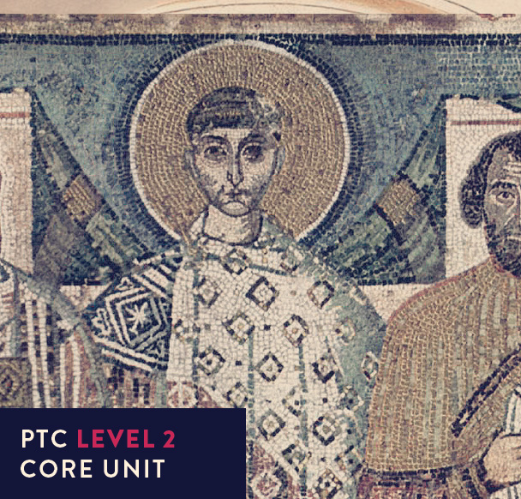
Early Church History

Slide 2



UNIT 6
A new era:
Accepted and respected

Slide 3
“To the Emperor Caesar Flavius Constantine, Maximus, Pius, Felix, Augustus, the Roman Senate and People dedicated this arch, decorated with his victories, because, by the prompting of the Divinity, by the greatness of his mind, he with his army, at one moment by a just victory avenged the State both on the tyrant and on all his party.
To the liberator of the city. To the establisher of peace.”

Slide 4

AD 284
D___________________, a popular military commander, becomes emperor of a disintegrating, unmanageable Roman empire – he proves to be a skilled statesman and reformer.

Slide 5
AD 284
He governs from
N___________________ in Bithynia.
AD 286

Slide 6
AD 284
He sets up the
T____________________ and
shares power with three others.
AD 286
AD 293

Slide 7
AD 284
AD 286
AD 293
Suddenly orders persecution of Christians.
AD 303

Slide 8
AD 284
AD 286
Abdicates, succeeded by
G_______________ who is even
more determined to exterminate
Christianity.
AD 293
AD 303
AD 305

Slide 9
AD 284
AD 286
AD 293
On his deathbed, G_____________
issues an edict of toleration.
AD 303
AD 305
AD 311

Slide 10
AD 284
Dies, leaving a struggle for imperial power.
Constantine advances across the Alps and
defeats his rival M______________________ just
outside Rome at M___________ B____________.
AD 286
AD 293
AD 303
AD 305
AD 311
AD 312

Slide 11
Constantine's Conversion
“Constantine was directed in a dream to mark the heavenly signs of God on the shields of his soldiers and thus to join battle. He did as he was ordered and with the cross-shaped figure X, with its top bent over, he marked Christ on the shields.”
(Lactantius)

Slide 12
Constantine's Conversion
“Constantine saw the contrast between the gods of paganism who failed to protect their worshippers, and his father Constantius' monotheism, and decided to cleave to the latter.
...while he was thus praying with fervent entreaty, a most incredible sign appeared to him from heaven, the account of which it might have been hard to believe had it been related by any other person...
He said that about noon, when the day was already beginning to decline, he saw with his own eyes the trophy of a cross of light in the heavens, above the sun, and an inscription, CONQUER BY THIS attached to it …
then in his sleep the Christ of God appeared to him with the sign which he had seen in the heavens, and commanded him to make a likeness of that sign which he had seen in the heavens, and to use it as a safeguard in all engagements with his enemies.”
(Eusebius)

Slide 13
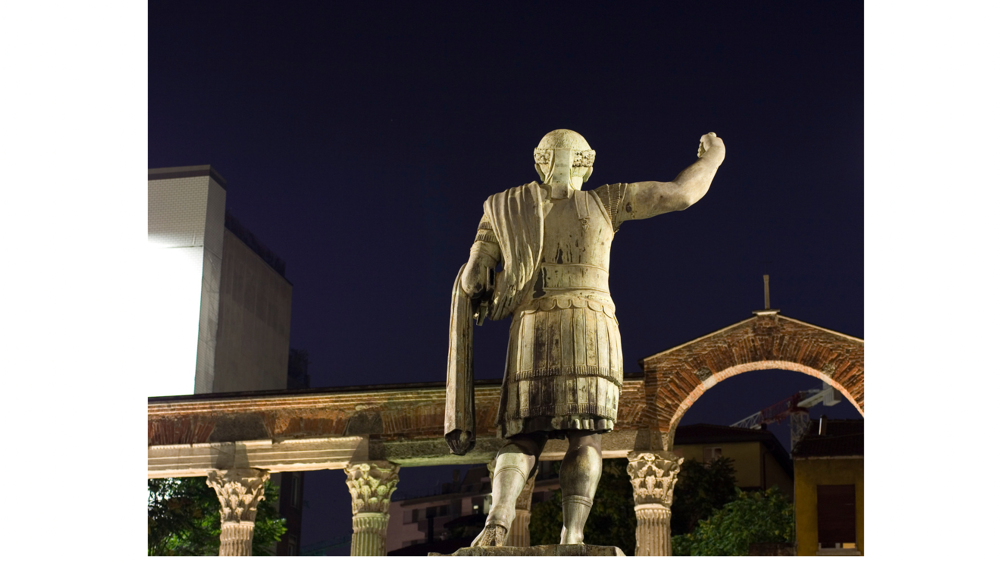
From 312 Christianity, persecuted and despised in Roman society, became the spiritual leader, almost overnight, of this vast and powerful empire.

Slide 14
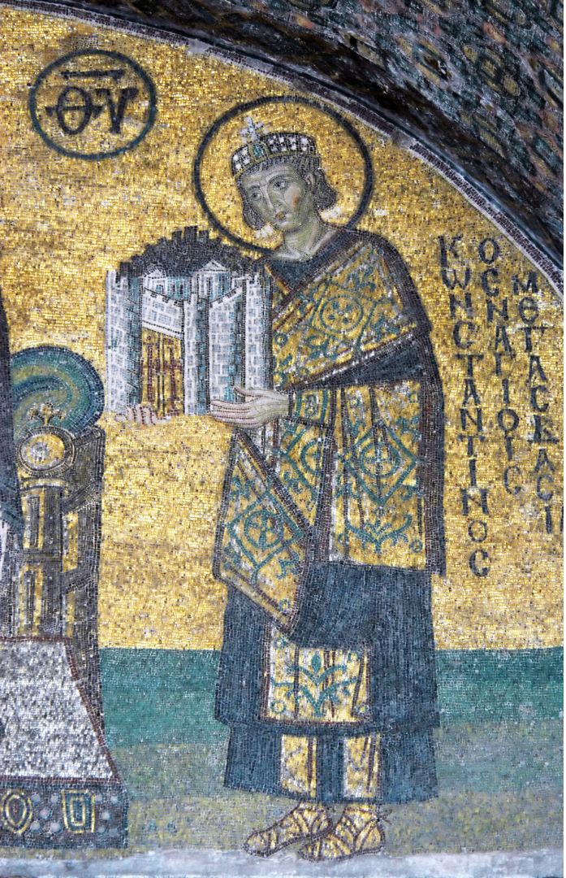
Constantine favours Christianity openly
- Christian ministers enjoy tax exemptions
- he makes generous donations to the church
- crucifixions are abolished
- in 321 makes Sunday a holiday
  and privately – his sons and daughters are raised as Christians and he leads a Christian family life.

Slide 15

He opposes the Donatists.
“What higher duty have I as emperor than to destroy error and repress rash indiscretions, and so cause all to offer to Almighty God true religion, honest concord and due worship?”

Slide 16
He opposes the Dentists
He threatened to go to Africa and sort them out personally. That didn't happen but he ordered their churches to be confiscated and their leaders banished, only abandoning this persecution in 321!

Slide 17
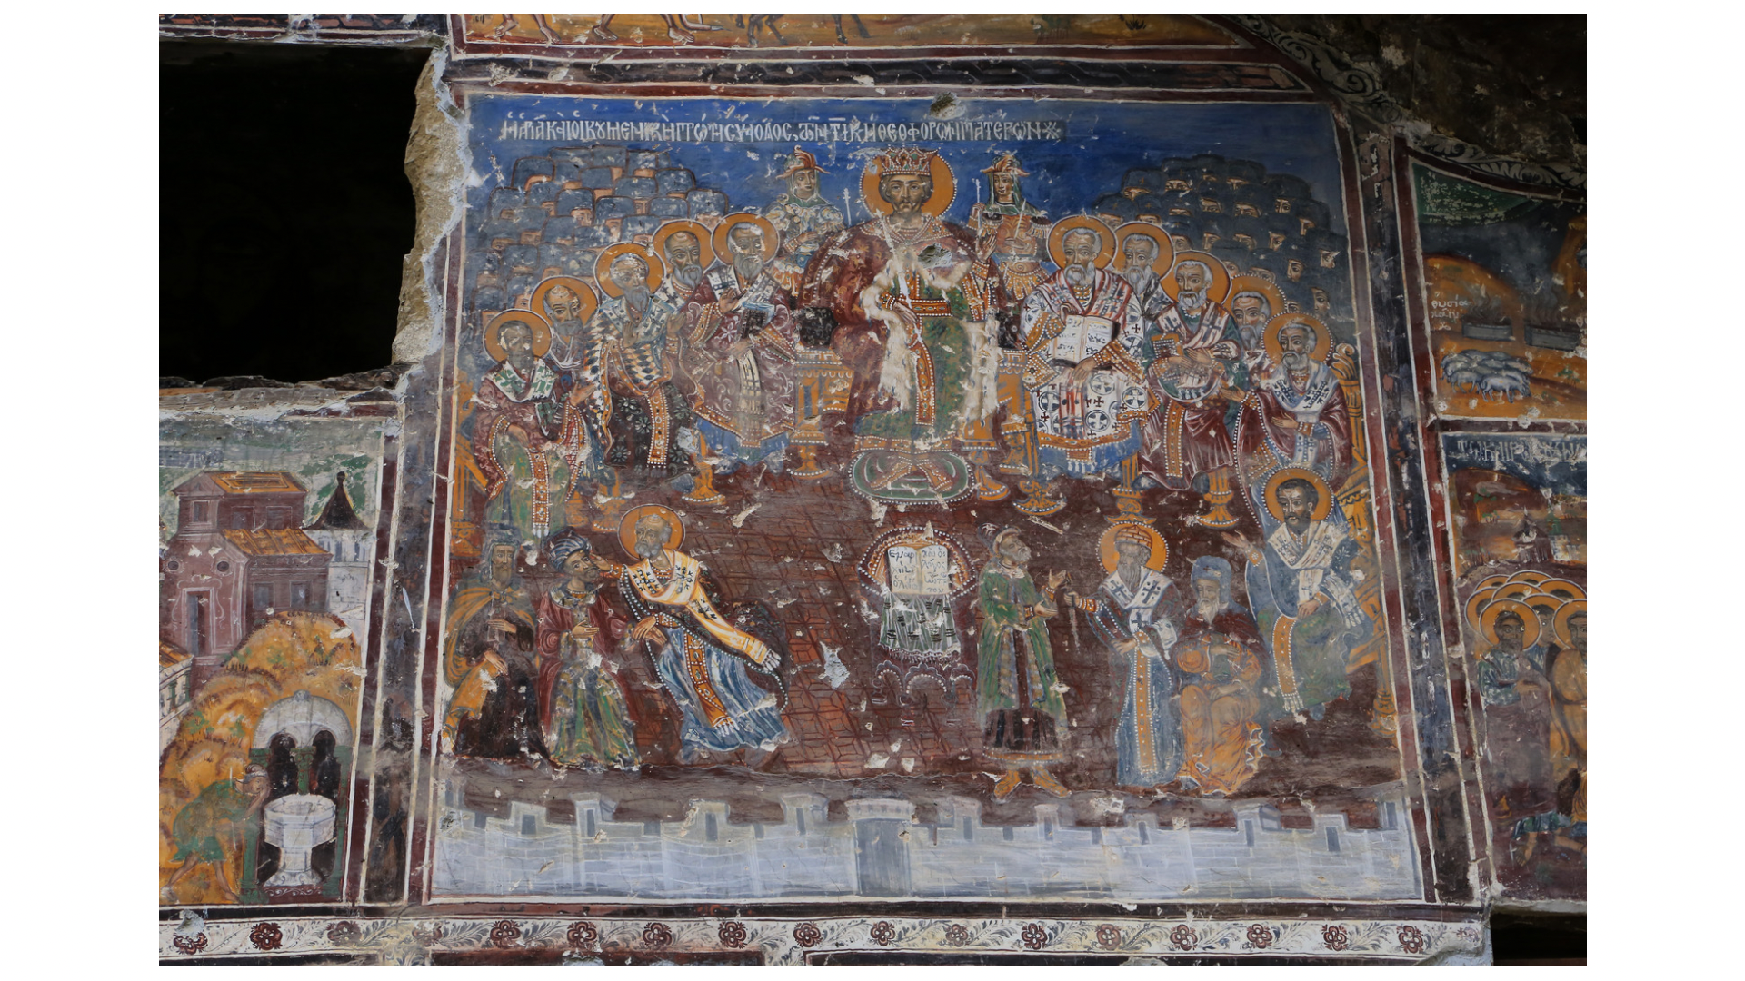
When Constantine became sole emperor in 324 he discovered in the east a raging dispute involving an Alexandrian presbyter called Arius. Initially describing the problem as 'trifling' he realised the problem was not going to be settled easily and called a Council of the whole church – at Nicaea 325.

Slide 18
Nicaea 325.
“........ in order that I may be present as a spectator and participator in those things which will be done.”

Slide 19
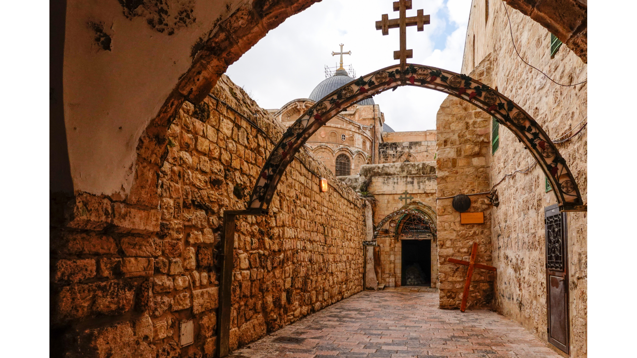
He, and his mother Helena, made Jerusalem a 'Christian' city, a place for pilgrims.
They identified(?) the place of Jesus' burial (under Emperor Hadrian's Temple of Venus) and Helena discovered the 'True Cross' on which Jesus was crucified!

Slide 20
He addressed a group of bishops (probably in 336):
“You are bishops where jurisdiction is within the Church: I also am a bishop, ordained by God to overlook those outside the Church.”
Eusibius adds: 'He watched over all his subjects with an episcopal care, and exhorted them as far as in him lay to follow a godly life.'

Slide 21
337 He becomes ill immediately after Easter and is baptised (deathbed baptisms were quite normal at the time).
“The hour has come in which I too may have the blessing of that seal which confers immortality…….”
He refused to wear purple after this and died on Pentecost Sunday.

Slide 22
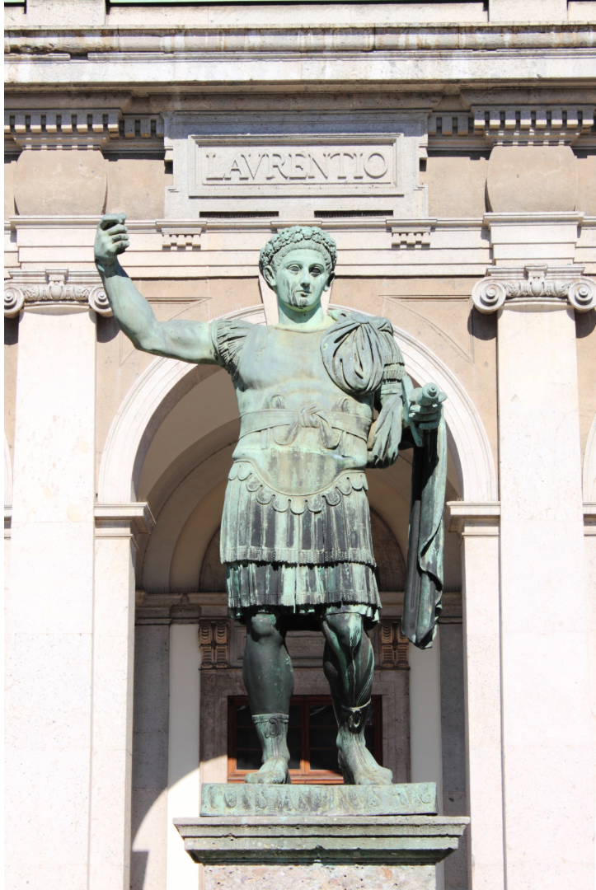
Reflection questions
How did the gospel message benefit from Constantine's professed Christianity?
Was it genuine faith or political wisdom?
Nominal Christianity spread throughout the empire as life for believers became easy, but was something lost too?

Slide 23

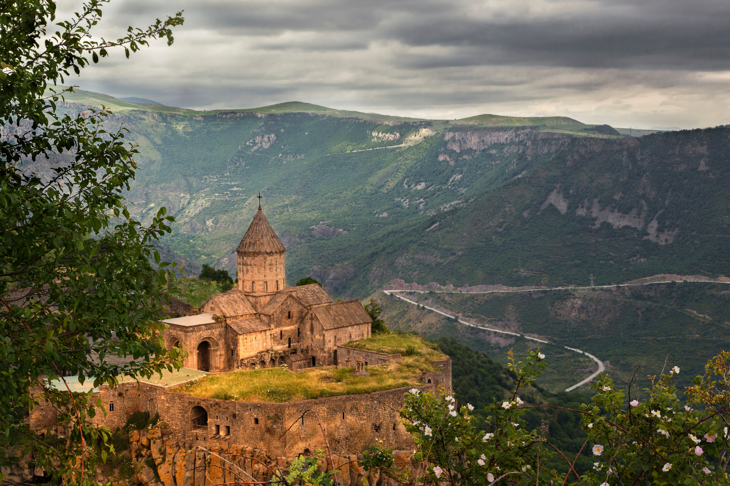
Armenia
Armenia claims to be the first country to declare itself a Christian country (301 AD). While this has been officially recognised since the Middle Ages (and still is) it is impossible to unearth historical truth beneath legend and tradition.

Slide 24
Armenia
King Tiridate tortured and imprisoned his nephew Gregory and when the beautiful Hripsime refused to join his harem, she and and other martyrs were put to death. The King was transformed by an act of divine vengeance into a wild boar but became a man again when Gregory was released. Tiridate converted to Christianity and had all the heathen shrines destroyed. Gregory “the Illuminator” was consecrated as Bishop of Armenia.

Slide 25
Reflection / Question over coffee
What advantages or disadvantages can you list for a close partnership between church and state?
Early Church History

