Slide 1

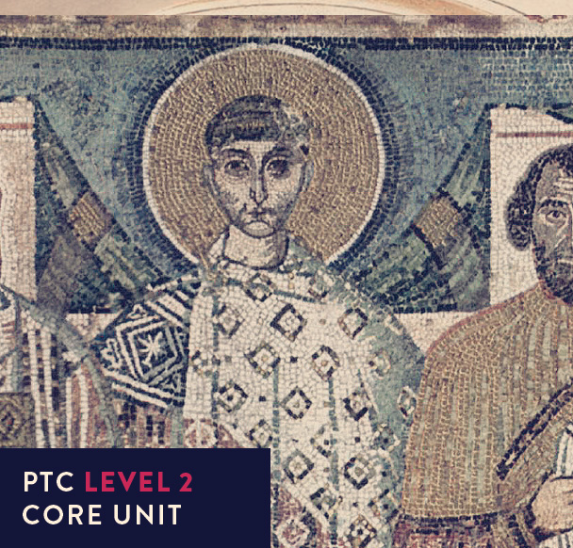
Early Church History

Slide 2



UNIT 3
Challengers and Champions:
Heresies in the first centuries

Slide 3

First century challenges to the truth
Where in the New Testament do we get glimpses of challenges to the truth from within the church and from external false teachers?

Slide 4
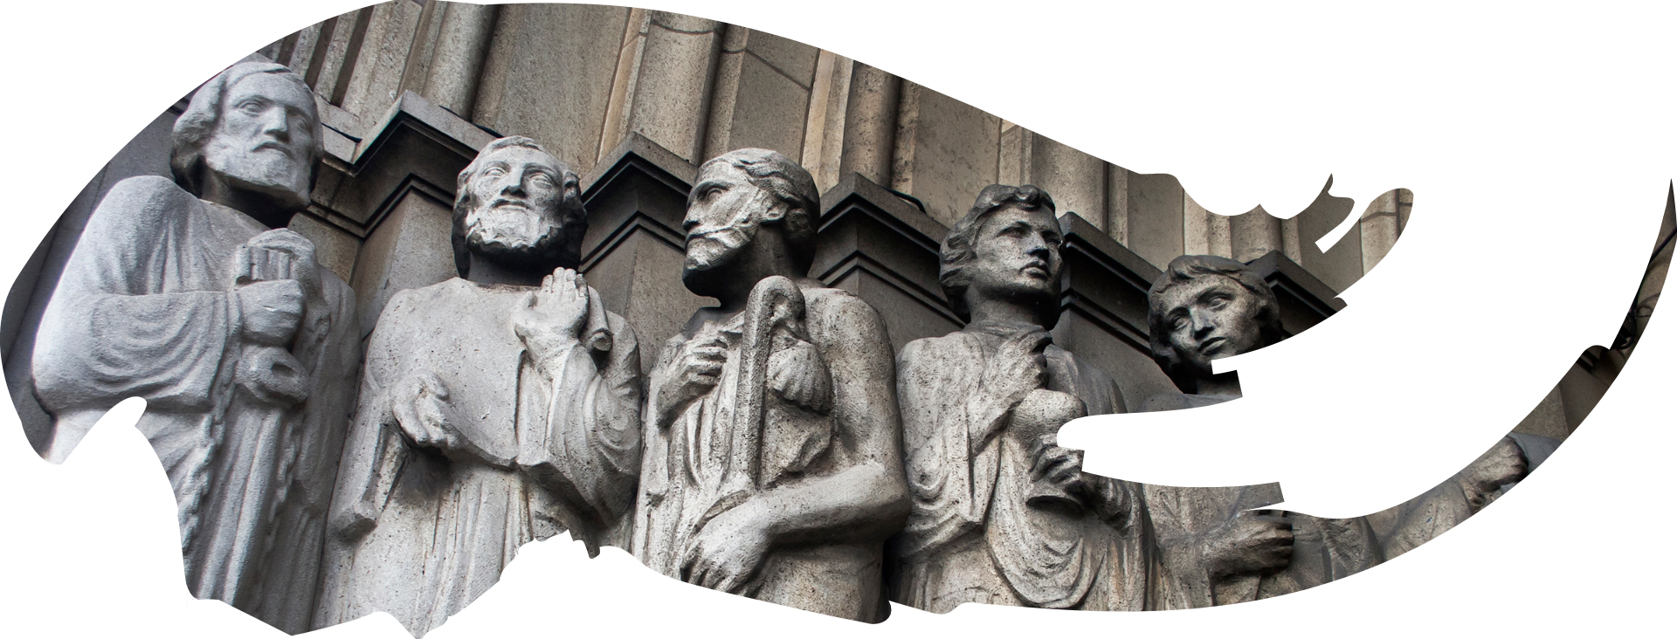
First century challenges to the truth
We can, to some extent discern what the false teaching was from the way that the writers of some of the Epistles sought to refute or correct certain teachings.

Slide 5
Errors from Judaism
What did the Judaizers encourage and why?

Slide 6

Errors from Judaism
What did the Judaizers encourage and why?
Galatians 2:3
Acts 15
Galatians 4:10
Galatians 2:11-14

Slide 7

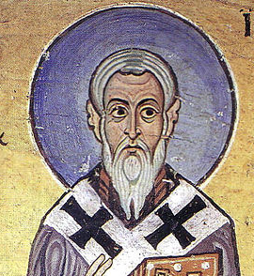
Errors from Judaism
What is at stake?
Galatians 5:2-6
Acts 15:11
'If we are still living in the practice of Judaism, it is an admission that we have failed to receive the gift of grace ... to profess Jesus Christ while continuing to follow Jewish customs is an absurdity. The Christian faith does not look to Judaism, but Judaism looks to Christianity'.

Slide 8
Errors from Judaism
Ebionism was a syncretistic approach to the gospel that combined Christianity and Orthodox Judaism, and persisted into the 3rd century.

Slide 9
Ebionism was a syncretistic approach to the gospel that combined Christianity and Orthodox Judaism, and persisted into the 3rd century.
Errors from Judaism
Observance of a great part of Jewish law.
Jesus was the human son of Jospeh & Mary,
- adopted by the Holy Spirit at his baptism
Jesus fulfilled the law as the new Moses & abolished the sacrificial system
In the virgin birth
That the writings of Paul were of God

Slide 10
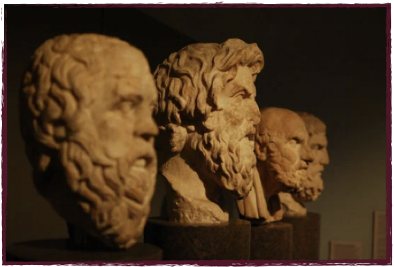
Errors from Greek influence - DOCETISM

Slide 11

Errors from Greek influence - DOCETISM
Evil
Good

Slide 12
Errors from Greek influence - DOCETISM
What is at stake?
The doctrines of incarnation and creation.
The Word did not become flesh,
  but only appeared or assumed so (to seem).
Jesus was not full human.

Slide 13
Errors from Greek influence - DOCETISM
What is at stake?
The doctrines of incarnation and creation.
The Word did not become flesh,
  but only appeared or assumed so (to seem).
The doctrines of incarnation and creation.
Jesus was not full human.
The Apostle John’s answer
John 1:14
1 John 1:1
1 John 4:2

Slide 14

Errors from Greek influence - DOCETISM
Polycarp, (letter to the Philippians 7, 1)
RESPONSE
To deny that Jesus has come in the flesh is to be Antichrist.

Slide 15
Errors from Greek influence
Gnosticism
from the Greek work gnosis (to know)
Based on the dualism of Docetism
Material world = Evil
Spiritual world = Good

Slide 16

Errors from Greek influence
Gnosticism … THUS:
God, the supreme divine being is UNKNOWABLE
The lesser god who carried out God’s dealings in the material world was the DEMIURGE
The supreme god was was ultimate GOODNESS and TRANSCENDENCE
The series of male and female lesser divine beings (aeons) formed the PLEROMA
The involvement of the demiurge gave some the spark of THE DIVINE imprisoned in EVIL FLESH
Those with this spark were SPIRITUAL those without were FLESHLY
You are saved not from sin but from IGNORANCE
The disassociation from the material world led to two ethical extremes: denying of the flesh (ASCETICISM) or because the flesh was inconsequential - LIBERTINISM

Slide 17
Errors from Greek influence
Gnosticism … Christological heresy:
Jesus was just an emissary of the divine being, bringing gnosis to the spiritual.
He could not be incarnate or crucified.

Slide 18
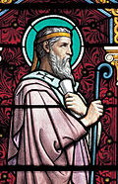
Errors from Greek influence
Iranaeus, (Against Heresies)
Merely to describe it showed how ludicrous it was.
There are NO secret apostolic teachings.
Both the OT and NT are Scripture.
RESPONSE

Slide 19
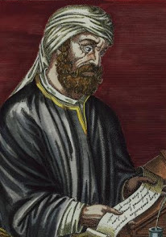
Errors from Greek influence
Tertullian & Hippolytus
There is no ‘creator god’ vs ‘supreme god’
Humanity is both physical and spiritual
Sin is not the inherent nature of matter but a result of the Fall.
RESPONSE

Slide 20

Errors from Greek influence
Tertullian & Hippolytus
Incarnation
Bodily resurrection of Christ
“Trinity”
RESPONSE

Slide 21
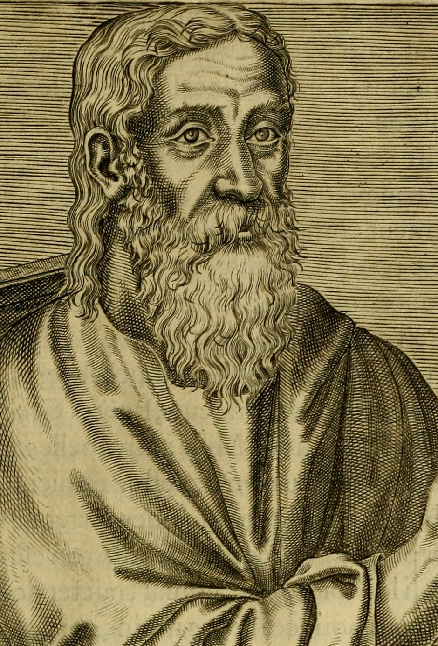
Errors from Greek influence
Clement of Alexandria
Was a philosopher-theologian who opposed Gnosticism (but retained elements of Docetism).
RESPONSE

Slide 22
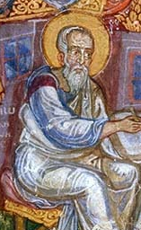
Errors from Greek influence - MARCIONISM
Marcion (85-160) was the son of a bishop in Pontus. In 140 he was influenced by a Gnostic teacher, Cerdo. He formulated his own beliefs and gathered believers and was excommunicated four years later. What we know of his teaching comes from Tertullian’s 5 books, ‘Against Marcion’ and Justin Martyr’s ‘Apology’ (c. 155). Persisted into the sixth century.

Slide 23
Errors from Greek influence - MARCIONISM
LAW
GRACE

Slide 24

Errors from Greek influence
LAW
Marcionism … THUS:
God of the Old Testament
VS
God of the New Testament
GRACE
Gracious
Good
Loving
Revealed in Christ
Morally superior
Law giving
Severe & vengeful
Only concerned with the Jews
Capricious, ignorant & cruel

Slide 25
Errors from Greek influence
Marcionism … Christology:
flesh but not flesh, man but not man, God yet not God.
THUS:
His sufferings and human experiences only appeared real
There is no resurrection - either of Christ or believers.

Slide 26
Errors from Greek influence
Marcionism
Marcion rejected the entire OLD TESTAMENT and those New Testament books that possessed a JEWISH FLAVOUR (Mark, Matthew, Acts, Hebrews, the pastoral epistles, some of Luke + any passages that contained the above).
He believed that the apostle Paul was the only apostle who did not misrepresent the gospel of grace.
THUS:

Slide 27
Errors from Greek influence
Marcionism
Every Apologist from Justin Martyr onwards (including Iraneus) addressed Marcionte teaching. These apologists (120-220) tried to give a reasoned defence and recommendation of the Christian faith by:
Appealing to THE AUTHORITIES FOR JUSTICE
Attacking PAGAN BELIEFS AND PRACTICES
Presenting CHRISTIAN BELIEFS AND LIFESTYLES FAVOURABLY
Giving THEOLOGICAL REASONS FOR THE TRUTH OF CHRISTIANITY
Arguing for THE FULFILMENT OF THE JEWISH LAW IN CHRIST
RESPONSE

Slide 28
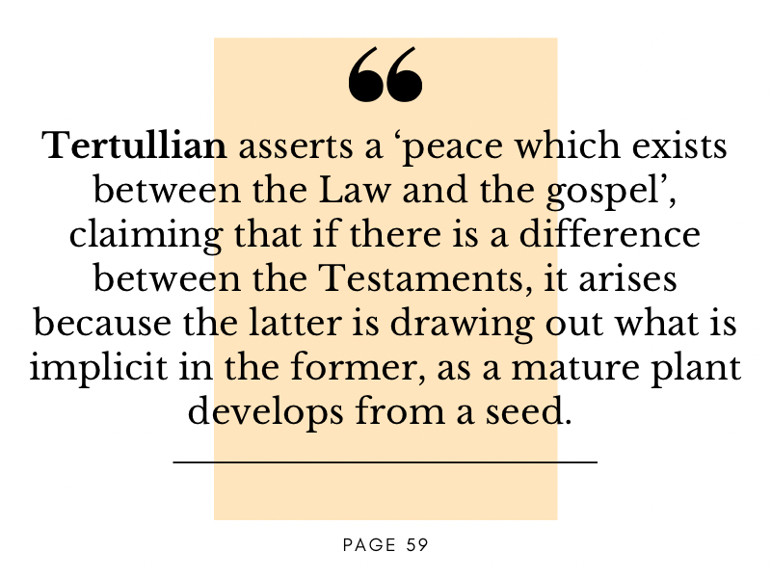
Errors from Greek influence
Marcionism
RESPONSE

Slide 29
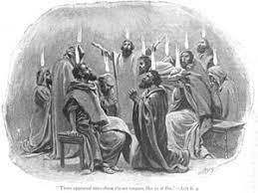
Errors from Greek influence
Montanism
The other main deviation from Orthodoxy in the second century (c. 172), but with no direct link to Gnosticism. Was a reactive movement (a ‘fresh work of the Holy Spirit’) to the formalism of church (where the spiritual energy and excitement seemed to have been lost).
Montanus lived in Phrygia, as a pagan priest who practised fasting, prophesied and received visions, inflicting pain on himself. Converted before 156AD he claimed to be the ‘Paraclete’s mouthpiece’.

Slide 30
Errors from Greek influence
Montanism - claims
The age of the HOLY SPIRIT (Paraclete) had arrived in him and spoke through him in his 2 prophecies.
The NEW JERUSALEM would be soon established in Pepuza (a local town).
Great expectation and urgency was thus required to prepare for the RETURN of CHRIST.
Preparation was by strict ASCETICISM .
As all energies were to be focused on this preparation so it was necessary to withdraw from all MUNDANE or EARTHLY activities.

Slide 31
Errors from Greek influence
Montanism
Epiphanies and Eusebius tell us that it was opposed by second century writers such as Apollinaire’s and Mitiades, even though none of the responses are available to us today. Was formally condemned before 200AD.
Tertullian actually joined the movement later in life, attracted by the high moral ideals.
RESPONSE

Slide 32
Errors from Greek influence
THE APOLOGISTS
During the second century pagan writers wrote criticising Christianity, including Celcus, a pagan philosopher who is answered by Origen in his work Against Celcus (a creative title!) where he compares pagan sayings to Christians to make the point that both have ‘scoundrels’ who take advantage of ‘gullible people’.
The works of the apologists were to influence the educated sections of the Roman world, explaining common misconceptions of the Christian faith and to persuade them of its worth. Although they recognised the passion of Christ as integral to salvation, the focus was on Jesus as teacher and moral exemplar.
RESPONSE

Slide 33
Errors from Greek influence
THE APOLOGISTS
The work of the apologists was an early attempt to contextualise the gospel, explaining, defending and placing it within its cultural context. In doing so, certain theological weaknesses, often bearing the influence of Greek philosophy, accompany a sincere effort to portray Christianity in the most favourable light. (Page 63)
RESPONSE

Slide 34
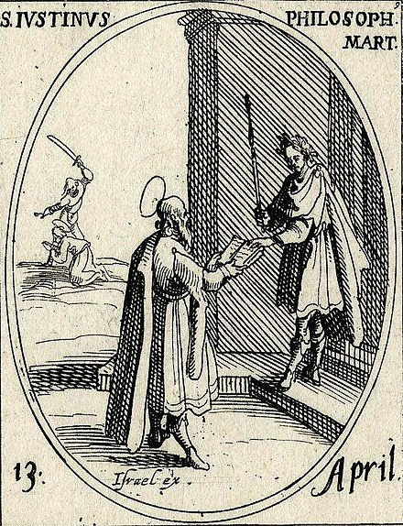
Errors from Greek influence
THE APOLOGISTS - Justin Martyr
A bearded Justin Martyr presenting an open book to a Roman emperor. Engraving by Jacques Callot.
RESPONSE
https://en.wikipedia.org/wiki/Justin_Martyr

Slide 35
Errors from Greek influence
THE APOLOGISTS - Justin Martyr
Justin Martyr (Flavius Justinus c. 100 - c. 165) is the best known of the Greek writing apologists studied philosophy and met an older Christian man who led him from Greek philosophers to Hebrew prophets to faith in Christ. He found Christianity to be the only true philosophy. For him, the pre-incarnate Word (Christ) gave philosophers their understanding which is why they contained elements of truth.
RESPONSE
https://en.wikipedia.org/wiki/Justin_Martyr

Slide 36
Errors from Greek influence
THE APOLOGISTS - Justin Martyr
  “Do you suppose that you will rise again and live forever?”
  “I do not suppose it, I know it!”
RESPONSE
https://en.wikipedia.org/wiki/Justin_Martyr

Slide 37
Reflection / Question over coffee
How wrong does an idea have to become for us to consider it ‘heresy’?
Early Church History

